Slide 2
Membership Tables
A | B | C | Y
0 | 0 | 0
0 | 0 | 1
0 | 1 | 0
0 | 1 | 1
1 | 0 | 0
1 | 0 | 1
1 | 1 | 0
1 | 1 | 1
A
B
C
Y

Slide 3
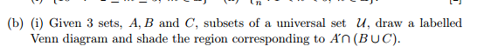
2006 Q2b

Slide 4
Membership Tables
A | B | C | Y
0 | 0 | 0
0 | 0 | 1
0 | 1 | 0
0 | 1 | 1
1 | 0 | 0
1 | 0 | 1
1 | 1 | 0
1 | 1 | 1
A
B
C
Y

Slide 5
Membership Tables
A | B | C | Y
0 | 0 | 0 | 0
0 | 0 | 1 | 1
0 | 1 | 0 | 1
0 | 1 | 1 | 1
1 | 0 | 0 | 0
1 | 0 | 1 | 0
1 | 1 | 0 | 0
1 | 1 | 1 | 0
A
B
C
Y

